Slide 1

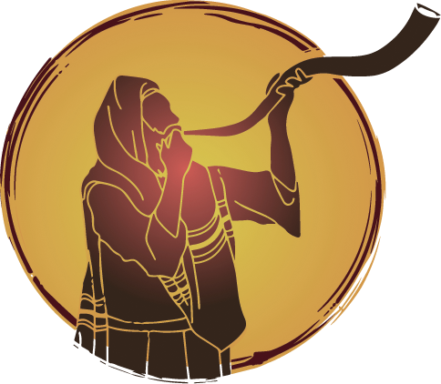
Little Is Much
When Yahuah Is In It!

Slide 2
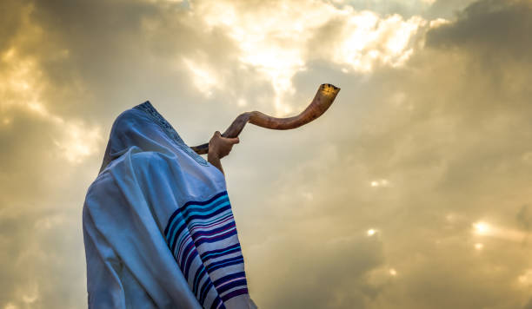

Why is the shofar important
What in the world does
a shofar
have to do with
Yahuah’s calendar

Slide 3
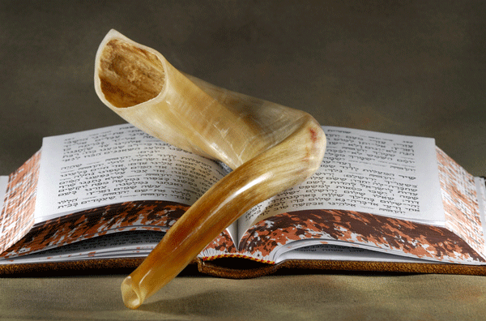
What does the Bible tell us about the Shofar?

Slide 4
Mention of Shofar Five Times in Torah
Exodus 19:16
Exodus 19:19
Exodus 20:18
Leviticus 25:9 (2x)
trumpet - H7782; showphar or shophar; a cornet (as giving a clear sound) or curved horn. שׁוֹפָר()
(There are 72 references in the Old Testament.)
trumpet - H2689; chatsotserah; by reduplication from H2690; a trumpet (from its sundered or quavering note):
KJV - trumpet (-er).
horn - H7161; qeren; a horn קֶרֶן from H7160;
a horn (as projecting); by implication, a flask, cornet; by resembl. an elephant's tooth (i.e. ivory), a corner (of the altar), a peak (of a mountain), a ray (of light); figuratively, power: KJV - hill, horn.
trumpet – G2279; echos; of uncertain affinity; a loud or confused noise ("echo"), i.e. roar; figuratively, a rumor: KJV - fame, sound.
trumpet - G4536; salpigx; perhaps from G4535 (through the idea of quavering or reverberation): “properly a war-trumpet” that boldly announces Yahuah’s victory. KJV - a trumpet.

Slide 5
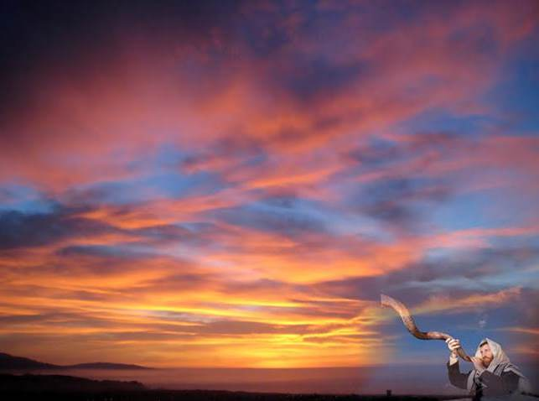
Some of the “72” Scripture References for Shofar
Josh 6:4 seven trumpets of rams’ horns
Josh 6:4 shall blow with the trumpets.
Josh 6:5 the sound of the trumpet,
Josh 6:6 seven trumpets of rams' horns
Josh 6:8 the seven trumpets of rams' horns
Josh 6:8 and blew with the trumpets: and the ark
Josh 6:9 that blew with the trumpets,
and the rereward
Josh 6:9 and blowing with the trumpets
Josh 6:13 seven trumpets of rams' horns
Josh 6:13 the people
Josh 6:16 blew with the trumpets,
Josh 6:20 when [the priests] blew with the
trumpets: and it came to pass,
when the people
Josh 6:20 the sound of the trumpet,
and the people; and he put a trumpet
in every man's hand …
Judges 3:27 that he blew a trumpet in
the mountain
Judges 6:34 and he blew a trumpet;
and Abiezer
Judges 7:8 in their hand, and their
trumpets: and he sent
Judges 7:18 When I blow with a
trumpet, I and all that [are]
with me, then blow
Judges 7:18 and all that [are] with me,
then blow

Slide 6
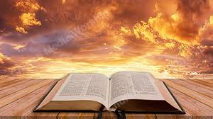
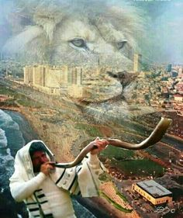

We will look into the Bible to see several instances where the Shofar was blown.

Slide 7
First Mention of the Ram’s Horn
The ram's horn, the Shofar, is a reminder of Abraham's sacrifice of Isaac and Yahuah's
provision of a ram as a substitute.
Genesis 22:13
And Abraham lifted up his eyes, and looked, and behold behind him a ram caught in a thicket by his horns: and Abraham went and took the ram, and offered him up for a burnt offering in the stead of his son.

Slide 8
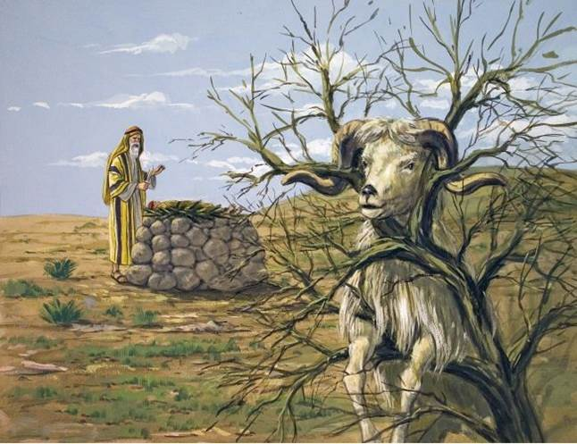
Yahuah Yireh, Our Provider,
First and foremost, thank You for providing eternal salvation for our souls and personal access to You. Thank You that You meet us right where we are. Thank You for the examples of those in history who believed in You as their Provider. Give us courage and faith to help us move ahead.
In Yahusha's Name, Amen.

Slide 9
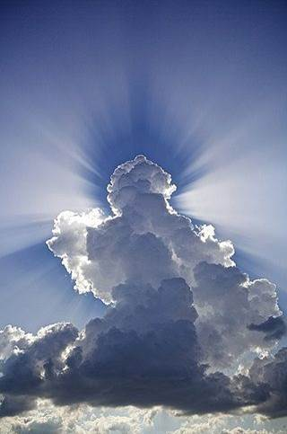
Exo 19:9 Yahuah said to Moses, Behold, I will come to you in a dense cloud, so that the people will hear when I speak with you,
and they will always put their trust in you.
And Moses relayed the words
of the people to Yahuah.

Slide 10
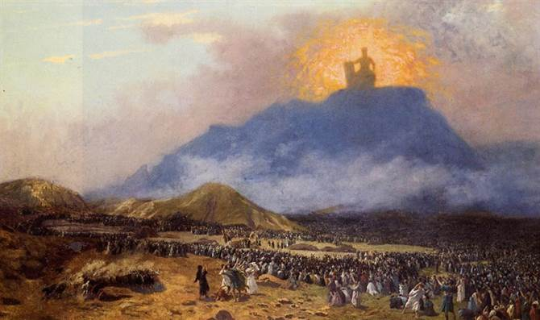
Exodus 19:16
And it came to pass on the third day in the morning, that there were thunders and lightnings, and
a thick cloud upon the mount, and the voice of the trumpet exceeding loud;
so that all the people that was in the camp trembled.
Heb 12:19
… and the blast of a trumpet [salpiggos] and a voice uttering words such that those who heard begged to hear no more.

Slide 11
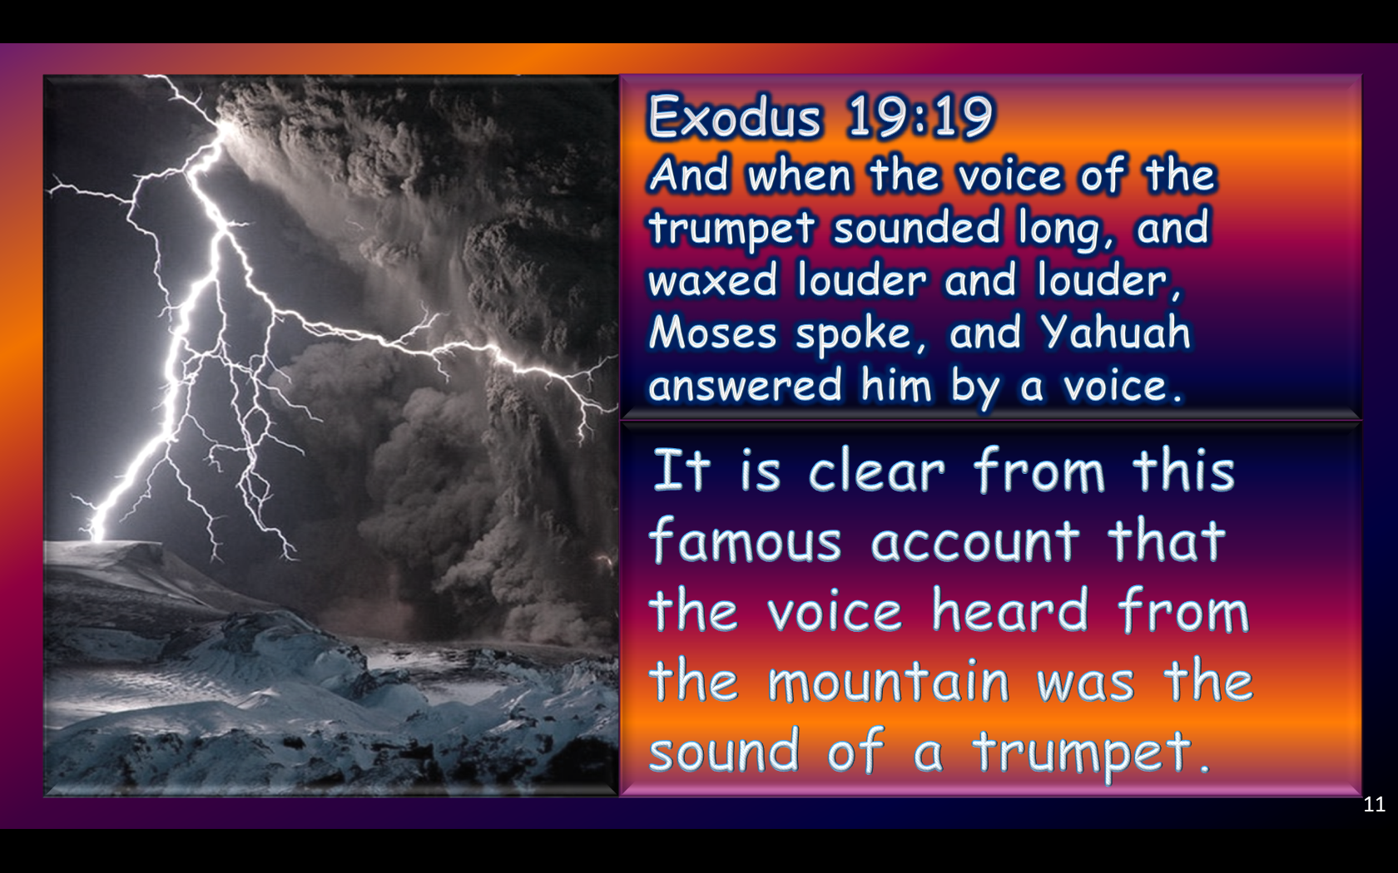
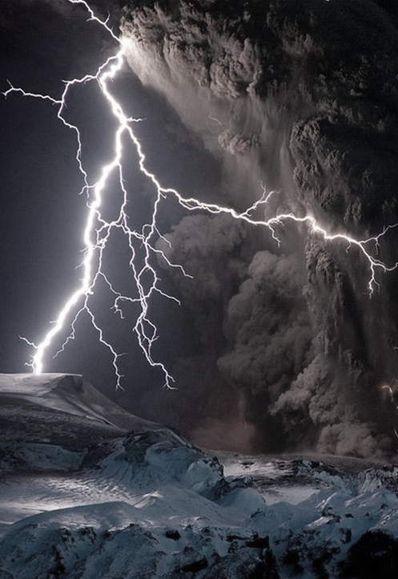
Exodus 19:19
And when the voice of the trumpet sounded long, and waxed louder and louder,
Moses spoke, and Yahuah answered him by a voice.
It is clear from this famous account that the voice heard from the mountain was the sound of a trumpet.

Slide 12
The Voice of Yahuah
The sound of the shofar is like the wind and breath of Ruach Ha Ko'desh that covers the people like a blanket. When this happens healing takes place and the wondrous miracles of Yahuah have an atmosphere to work in. We are first introduced to the shofar in the Book of Exodus when Yahuah tells Moses to gather the Israelites together at the foot of Mount Sinai to meet with Him. These were His instructions to Moses to warn the people.
Zechariah 9:14
Then Yahuah will appear over them;
his arrow will flash like lightning.
The Sovereign Yahuah will sound
the trumpet…
Could it be that the trumpet of Yahuah
is actually His voice rather than a trumpet that He places to His mouth and blows?

Slide 13
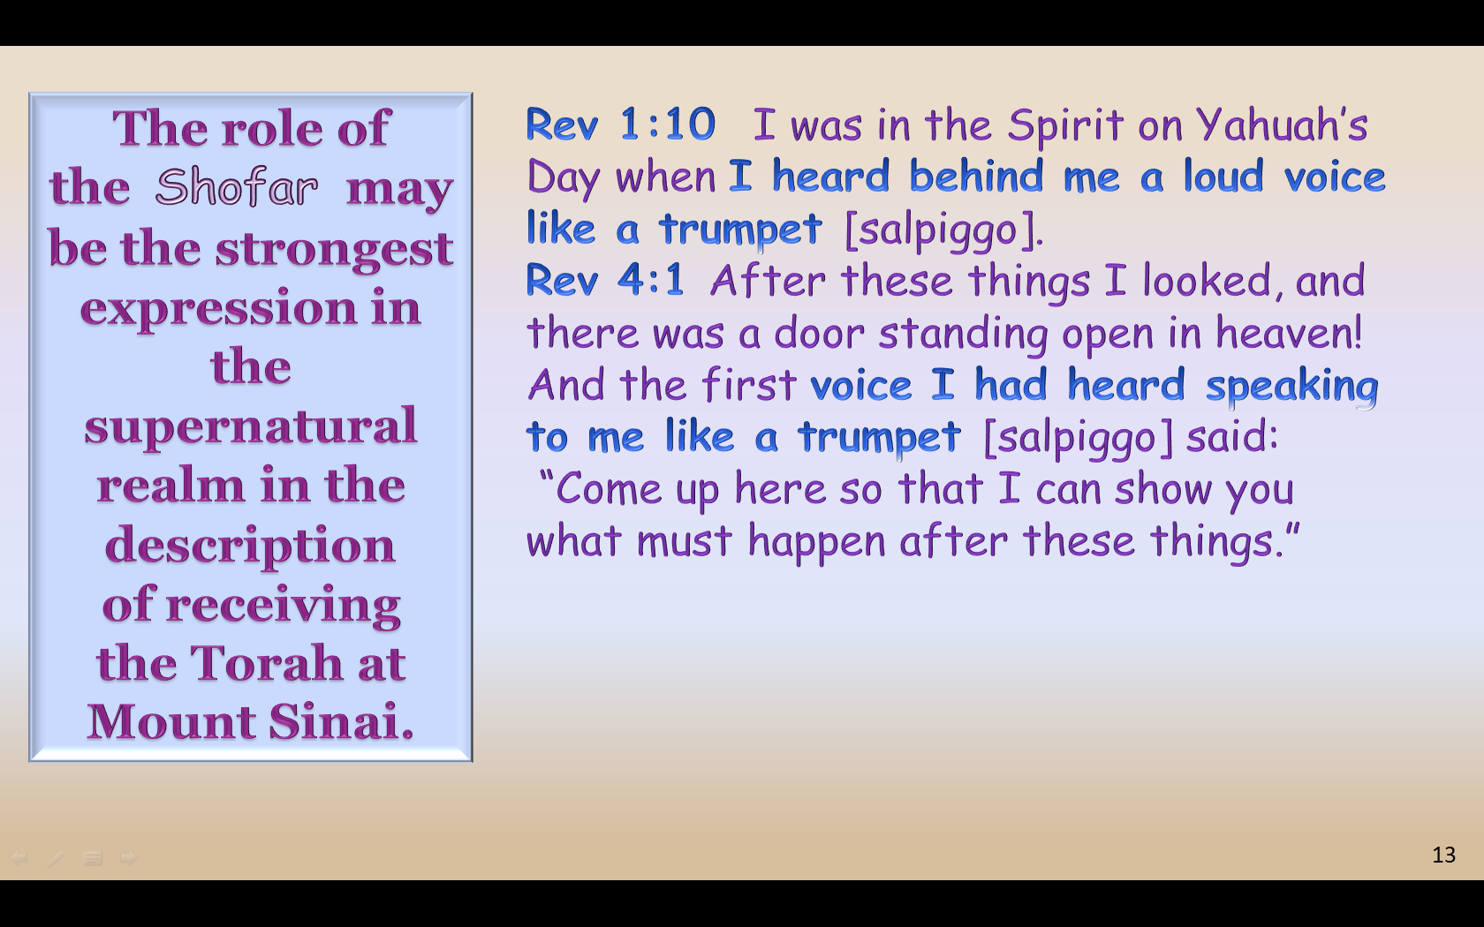
The role of the Shofar
may be the
strongest expression
in the supernatural realm in the description
of receiving
the Torah at
Mount Sinai.
Rev 1:10 I was in the Spirit on Yahuah’s Day when I heard behind me a loud voice like a trumpet [salpiggo].
Rev 4:1 After these things I looked, and there was a door standing open in heaven! And the first voice I had heard speaking to me like a trumpet [salpiggo] said:
“Come up here so that I can show you
what must happen after these things.”
A second root word for the Greek salpiggo is saino,
which means to be shaken, troubled or disturbed.

Slide 14
The Shofar is Yahuah’s War Club
Jeremiah 51:20
"You are my war club, my weapon for battle - with you I shatter nations, with you I destroy kingdoms …”

Slide 15
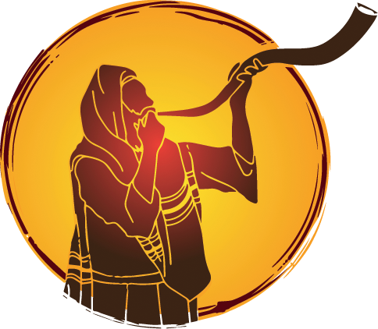
The Shofar
sounds out
an Announcement!

Slide 16
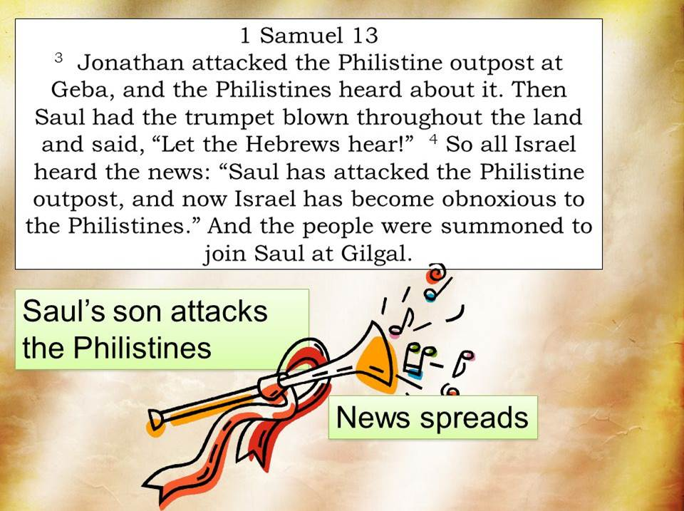

Slide 17
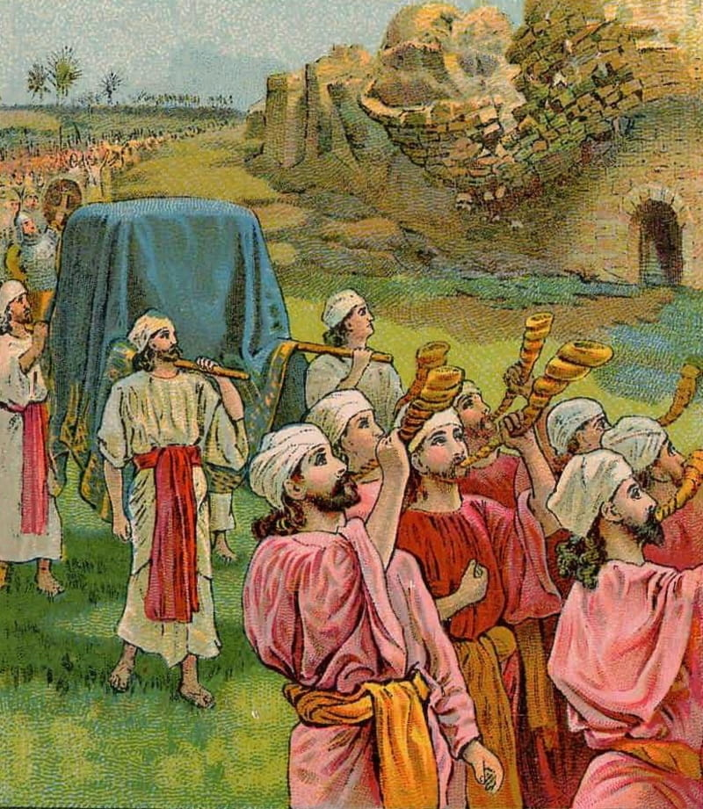
The Shofar is mentioned on occasions of festivals and worship, like on the occasion of bringing up
the Holy Ark.
2 Samuel 6:15
So David and all the house of Israel brought up the ark of Yahuah with shouting, and with the sound of the trumpet.

Slide 18
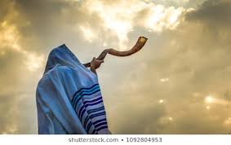
The Shofar’s “Warning Sign” for
Approaching Enemies
Hosea 5:8
Blow ye the cornet in Gibeah, and the trumpet in Ramah: cry aloud at Bethaven, after thee, O Benjamin.
Jeremiah 4:21
How long shall I
see the standard, and hear the sound of the trumpet.
Ezekiel 33:1-6
The prophet is likened to a scout blowing the Shofar to warn the people

Slide 19
The Shofar Announcing Rebellion
2 Samuel 20:1
Now a scoundrel named Sheba son of Bichri, a Benjaminite, happened to be there.
He sounded the trumpet and cried out, We have no portion in David, no share in the son of Jesse! Everyone to your tents, O Israel!

Slide 20
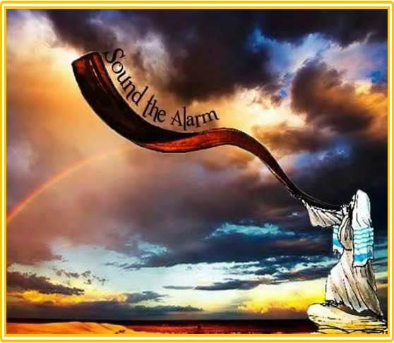
Leviticus 25:9
Then shalt thou cause the shofar to sound an alarm
on the tenth day of the seventh month; in the day of the reconciliations shall ye cause the shofar to sound throughout all your land.

Slide 21
Praise and Worship Begins With
the Sounding of The Shofar
Psalms 150
Praise Yahuah
Praise Him with the
sounding of the trumpet,
Let everything that has breath praise Yahuah.

Slide 22
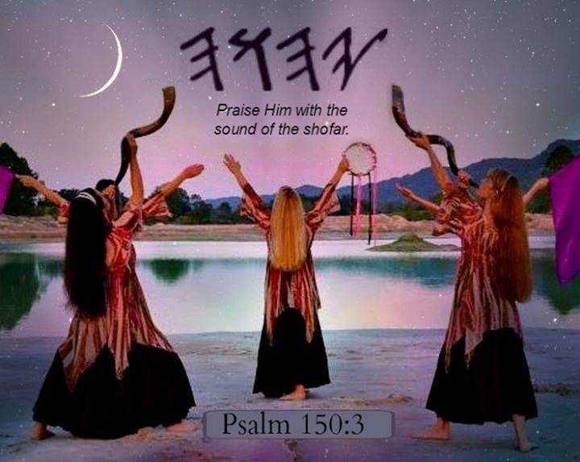

Slide 23
The
Shofar
Announces
Victory

Slide 24
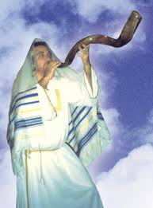
1 Samuel 13:3
And Jonathan attacked the garrison of the Philistines that was in Geba,
and the Philistines heard of it.
Then Saul blew the trumpet throughout all the land, saying, “Let the Hebrews hear!”
2 Samuel 18:16 And Joab blew
the trumpet, and the people
returned from pursuing after Israel: for Joab held back the people.

Slide 25
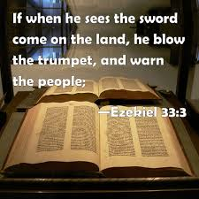
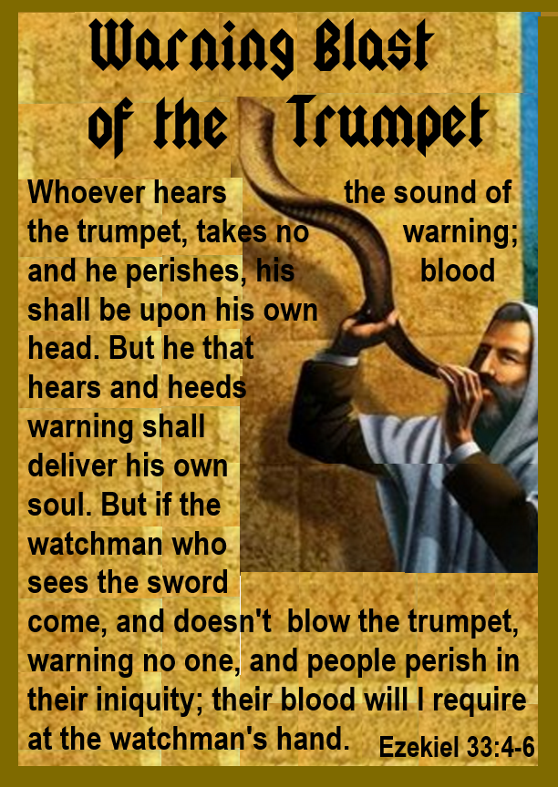
The Shofar Sounds a Warning
In Zephaniah 1:16, the prophet is likened to a scout blowing
the Shofar to warn the people.

Slide 26
The Shofar Sounds
to Signal the End of War
2 Sam 2:28
So Joab blew the shofar,
and all the people stood still and no longer pursued
after Israel, neither did
they fight any more.

Slide 27
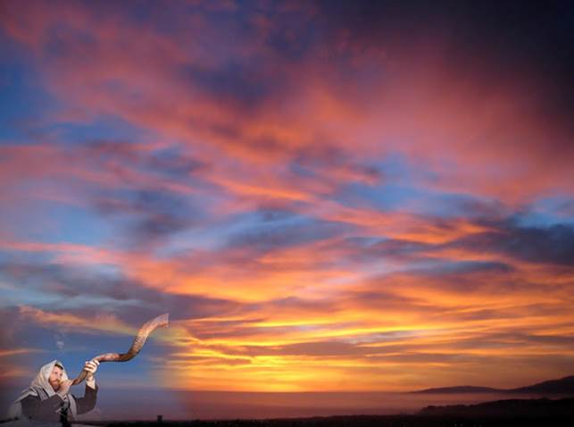
The Shofar Sounds
to Declare a Promise
They took an oath to Yahuah
with loud acclamation,
with shouting and with
trumpets and horns.
2 Chron 15:14

Slide 28
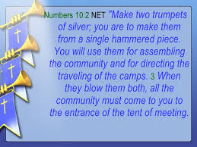
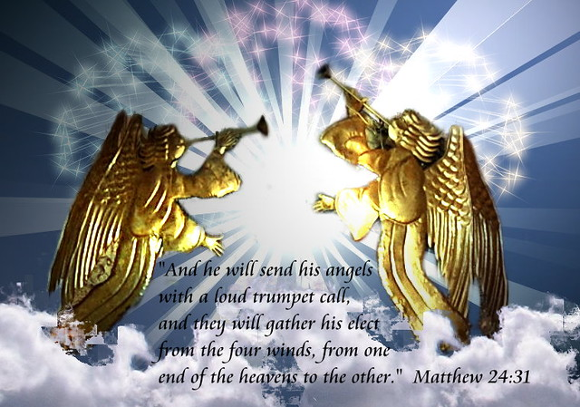
These two trumpets that will sound in the last day will be heard around the world. Their signal cannot be blocked by mankind.
Trumpets –
H2689; [chatsotserah]
a trumpet’s sundered
or quavering note
from a trumpeter.

Slide 29
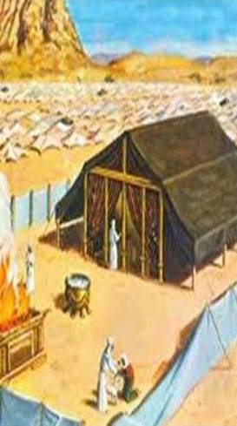
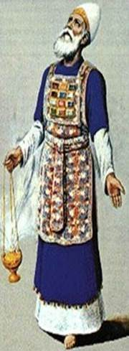
How Many Shofar/Trumpets Should Be Used?
Why are there only two trumpets? Why not 3, 12 or 10,000? Why are these under the jurisdiction of the High Priest
and not the people, Moses, or a king?
Aaronic
The Aaronic Priesthood is
a picture, or a type, of the Priesthood which is below the Melchizedek Priesthood.
Yahuah commanded Moses to build the earthly tabernacle exactly as it is in Heaven.
It’s a picture. All the items in the physical earthly tabernacles has a version in Heaven.
Melchizedek

Slide 30
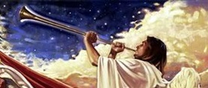
These silver trumpets have two primary purposes:
1. to summon the congregation
2. to set out on their journey.
These two silver trumpets are not shofars.
Trumpets [khatzotzerah] (Strong’s H2689).
They were silver, not derived from an animal.
They were under the control of the High Priest,
just as our High Priest Yahusha tells.
Matt 24:31 And He will send forth His angels with A GREAT TRUMPET and THEY WILL GATHER TOGETHER His elect from the four winds, from one end of the sky to the other.

Slide 31
Numbers 10:2-10
Yahuah said to Moses:
² “Make two trumpets of hammered silver, and use them for calling the community together and for having the camps set out.
³ When both are sounded, the whole community is to assemble before you at the entrance to the tent of meeting.
⁴ If only one is sounded, the leaders—the heads of the clans of Israel—are to assemble before you.
⁵ When a trumpet blast is sounded, the tribes camping
on the east are to set out.
⁶ At the sounding of a second blast, the camps on the south are to set out. The blast will be the signal for setting out.
⁷ To gather the assembly,
blow the trumpets, but not with the signal for setting out.
⁸ “The sons of Aaron, the priests, are to blow the trumpets. This is to be a lasting ordinance for you and the generations to come.

Slide 32
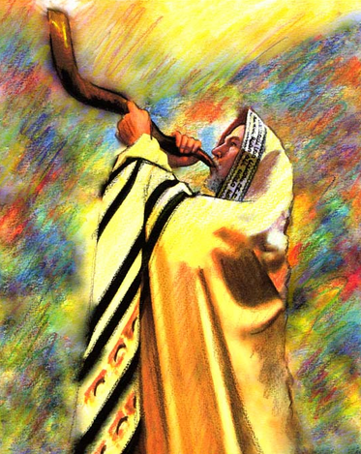
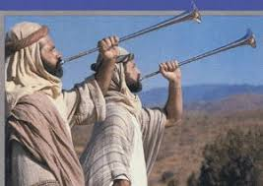
9 When you go into battle in your own land against an enemy who is oppressing you, sound a blast on the trumpets. Then
you will be remembered by Yahuah your Elohim and
rescued from your enemies.
9 When you go into battle in your own land against an enemy who is oppressing you, sound a blast on the trumpets. Then you will be remembered by Yahuah your Elohim and rescued from your enemies.
10 Also at your times of rejoicing your appointed festivals and New Month feasts - you are to sound the trumpets over your burnt offerings and fellowship offerings, and they will be a memorial for Yahuah before your Elohim. I am your Elohim.
10 Also at your
times of rejoicing
your appointed
festivals and New
Month feasts –
you are to sound
the trumpets
over your burnt
offerings and
fellowship offerings, and they
will be a memorial for Yahuah before your Elohim.
I am your Elohim.

Slide 33
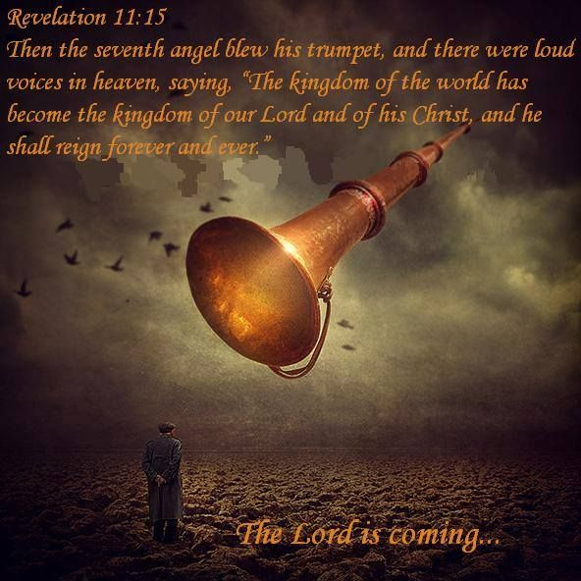
Sound of a Trumpet
This “sound of a Trumpet” could be a literal trumpet [or shofar] blowing, or it could be the voice of our Elohim sounding like a trumpet. This is the last chronological mention of silver
in the Bible.
There will be no silver in heaven for the reason of “redemption” because Yahuah’s people have already been redeemed.
Note: It did not matter if the sound was from a shofar, trumpet or horn. It was the message that was of most importance.
Yahusha is Coming…

Slide 34
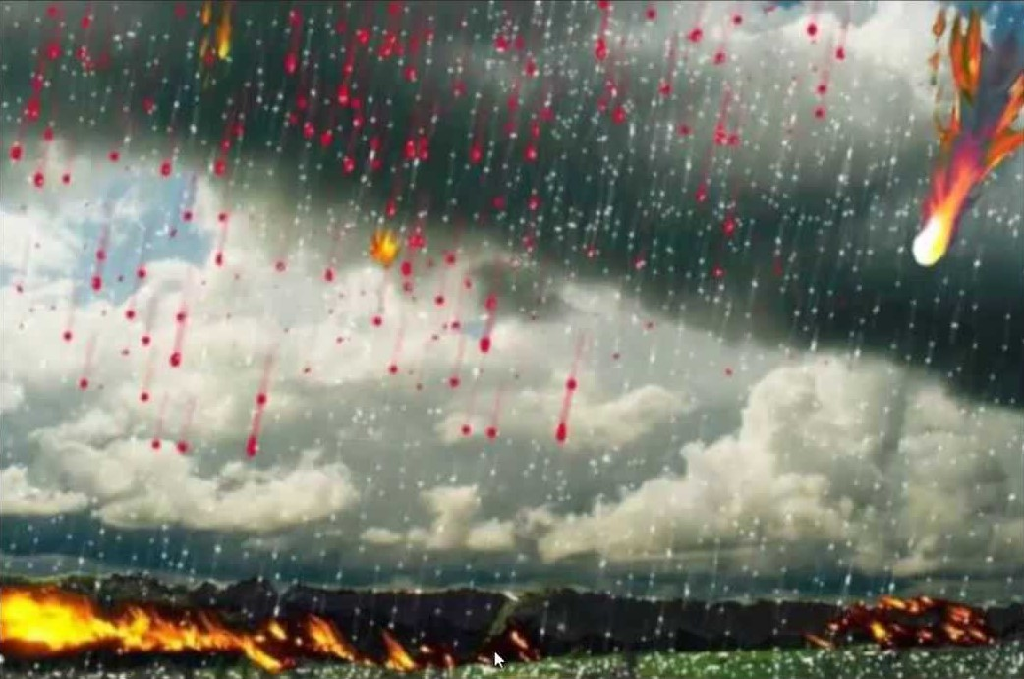
In Revelation 8:7, John describes an apocalyptic vision. His vision explains the triggering event of the sounding of the first trumpet — hail and fire mixed with blood falling to the ground, and approximately 33% of all of
the grass and trees in the
known world are destroyed.

Slide 35
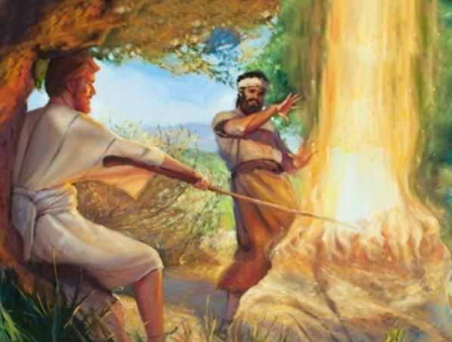
Judges 6:15
“Pardon me, my Elohim” Gideon replied, "but how can I save Israel? ... Behold, my clan is the weakest in Manasseh, and I am the least in my father’s house. ... my Elohim, wherewith do I save Israel? lo, my chief is weak in Manasseh, and I the least.”

Slide 36

A leader doesn’t always need
to be the boldest and most extroverted. Yahuah often works through believers who come from the least of the least, like Gideon. When we’re hiding from what scares us most, Yahuah compels us to tackle it head on.
We can often have various cushions that offer comfort. Maybe we have jobs that provide enough income for
a cozy retirement or other members of the church who step up into leadership roles we’d rather not fill ourselves. We can only hide on the threshing floor for so long before Yahuah pulls us out
of our comfort zones to do His amazing work.

Slide 37
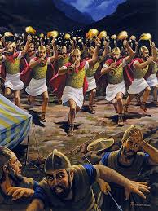
Judges 7
19 Gideon and the three hundred men with him reached the edge of the camp at the beginning of the middle watch, just after they had changed the guard. They blew their trumpets and
broke the jars that
were in their hands.
37

Slide 38
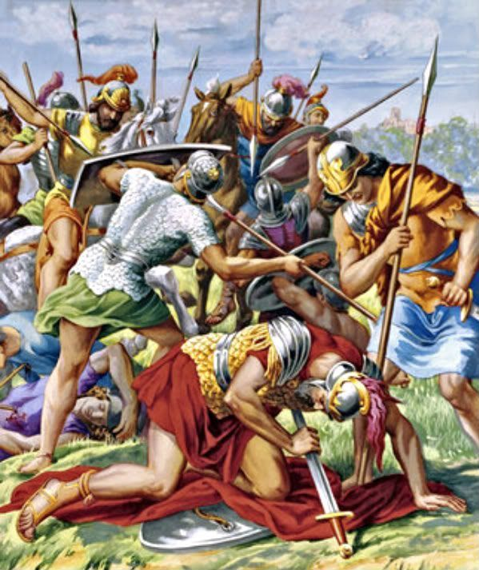
²⁰ The three companies blew the trumpets and smashed the jars. Grasping the torches in their left hands and holding in their right hands the trumpets they were to blow, they shouted,
“A sword for Yahuah and for Gideon!”
²¹ While each man held his position around the camp, all the Midianites ran, crying out as they fled.
²² When the three hundred trumpets sounded, Yahuah caused the men throughout the camp to turn on each other with their swords. The army fled
to Beth Shittah toward Zererah as far
as the border of Abel Meholah near Tabbath.

Slide 39
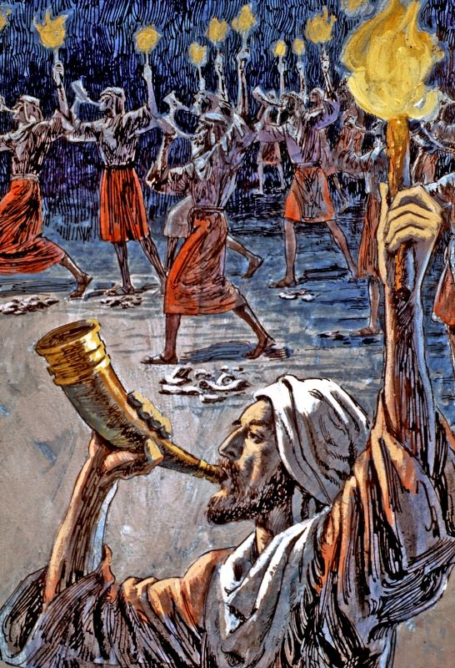
Ehud Judges 3
26 Ehud, however, had escaped while the servants waited. He passed by the idols and escaped to Seirah.
27 On arriving in Seirah, he blew the trumpet throughout the hill country of Ephraim. The Israelites came down with him from the hills, and he became their leader.
28 “Follow me,” he told them, “for Yahuah has delivered your enemies
the Moabites into your hands.” So they followed him down and seized the fords of the Jordan leading to Moab, and did not allow anyone to cross over …
39

Slide 40
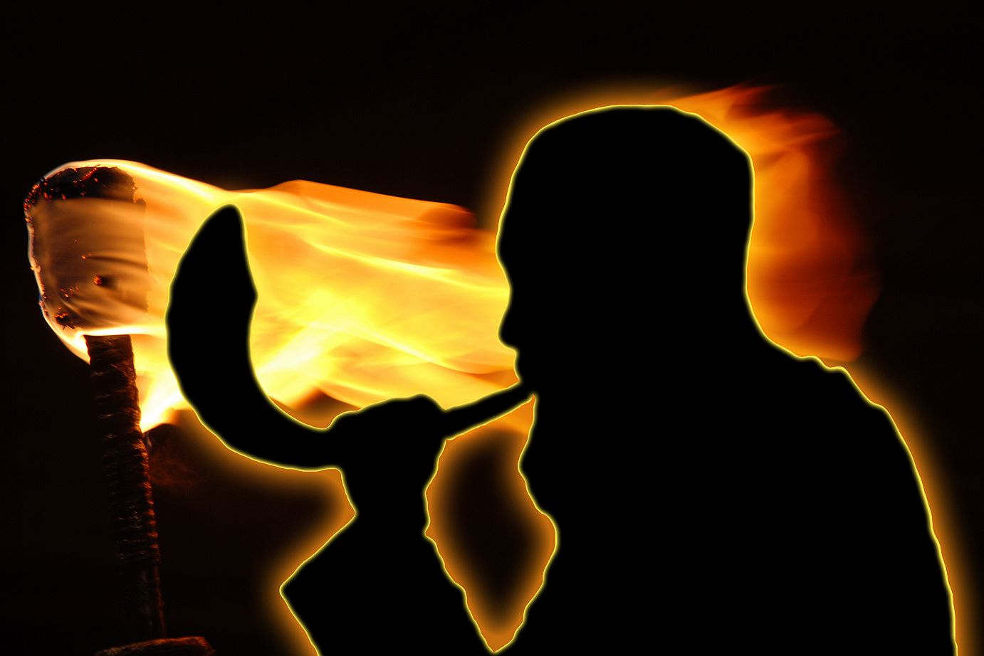
Again we see the Ruach Ha Kodesh using the weak things of this world in the weapons of Gideon's warfare! They are very simple: Lamp-pitchers and Shofars. That was all!
The lamp or
torches were
expressive of
the light and
fire of the
Ruach Ha Qodesh
The pitchers suggested
‘the broken vessel’s’
of our surrendered
bodies and lives.!
40

Slide 41
The Shofars
signified the
Word of Yahuah
{Yahuah’s voice}
and the message
of the Gospel
that we are sent
to proclaim!
These are the weapons
of our warfare, which are
still mighty through
Yahuah to the pulling
down of strongholds!
41

Slide 42
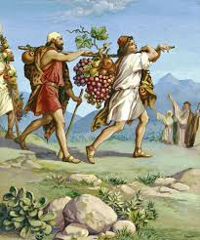
2 Sam 15:10
But Absalom sent spies throughout all the tribes
of Israel, saying, As soon as ye hear the sound of the shofar, then ye
shall say, Absalom reigns
in Hebron.

Slide 43
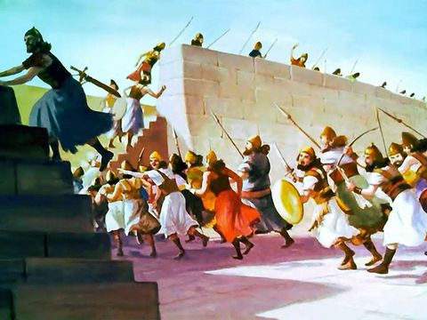
Demise of Jericho
Now Jericho was tightly shut up
because of the Israelites.
No one went out and
no one came in.
Then Yahuah said to Joshua,
“See, I have delivered Jericho
into your hands, along with
its king and its fighting men.”
Joshua 6:1-2
Let’s follow this shofar testimony.

Slide 44
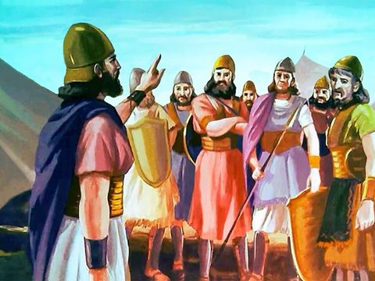
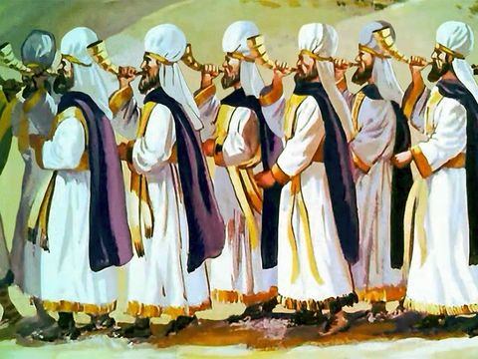
³ And ye shall compass the city, all ye men of war, and go round about the city once. Thus shalt thou do six days.
⁴ And seven priests shall bear before the ark seven trumpets of rams' horns: and the seventh day ye shall compass the city seven times, and the priests shall blow with the trumpets.

Slide 45
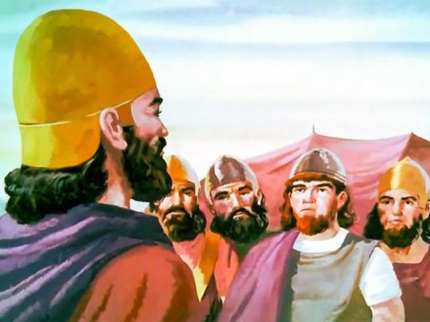
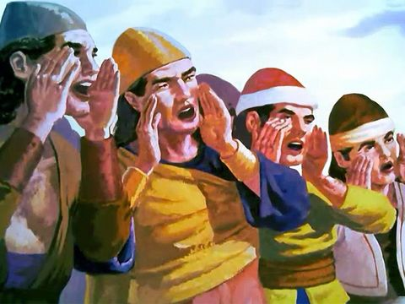
5. “When you hear them sound a long blast on the trumpets, have all the people give a loud shout; then the wall of the city will collapse …”

Slide 46
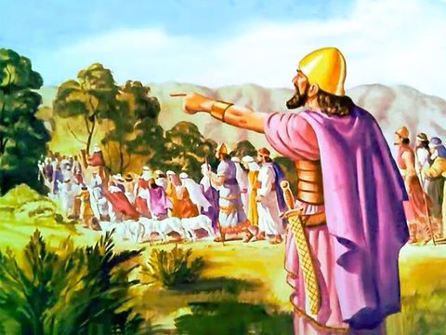
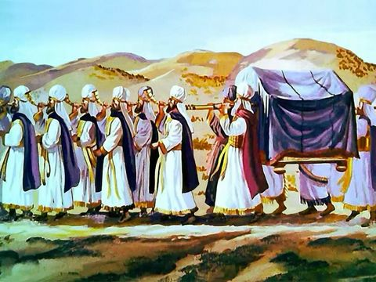
⁶ And Joshua the son of Nun called the priests, and said unto them, Take up the ark of the covenant, and let seven priests bear seven trumpets of rams' horns before the ark of Yahuah.
⁷ And he said unto the people, Pass on, and compass the city, and let him that is armed pass on before the ark of Yahuah.

Slide 47
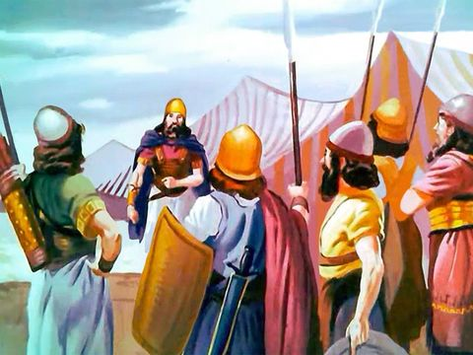
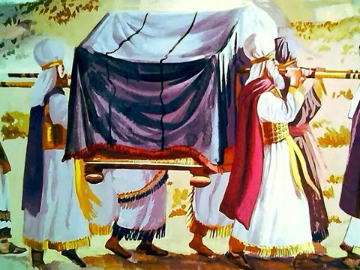
⁸ And it came to pass, when Joshua had spoken unto the people, that the seven priests bearing the seven trumpets of rams' horns passed on before Yahuah, and blew with the trumpets:
… and the ark of the covenant of Yahuah followed them.

Slide 48
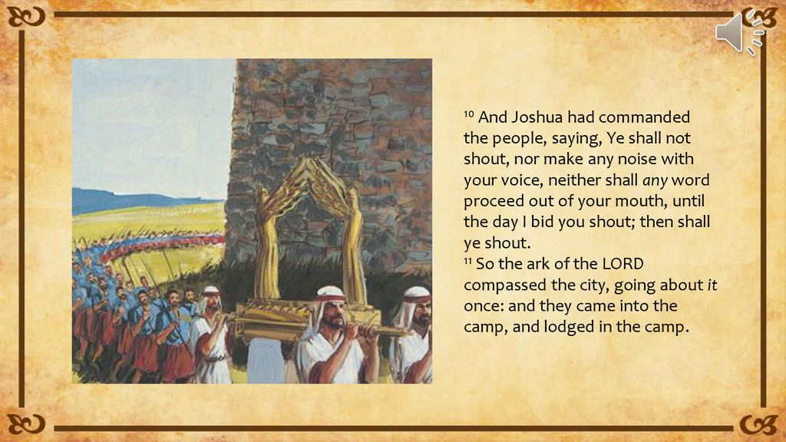
Joshua 6

Slide 49
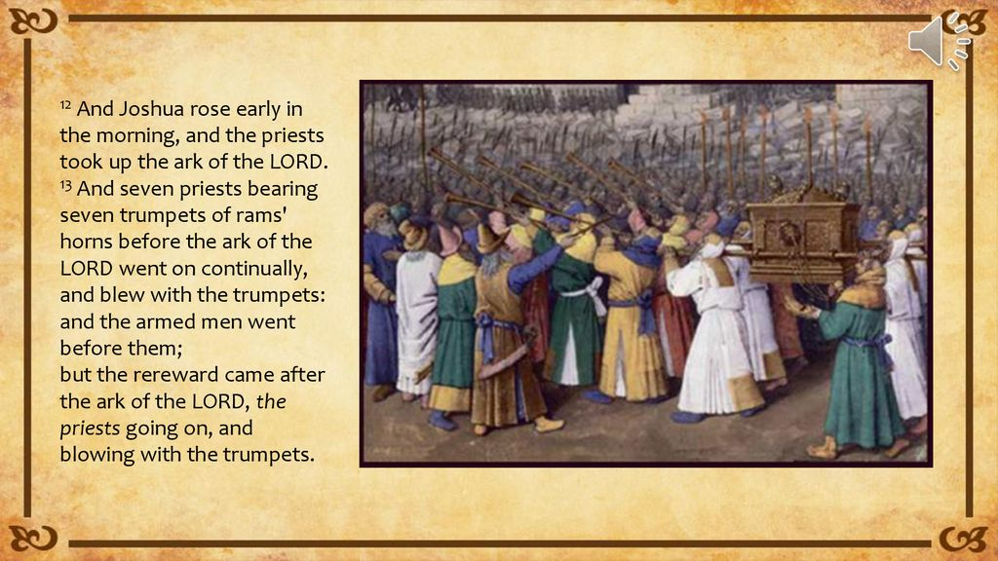
Joshua 6

Slide 50
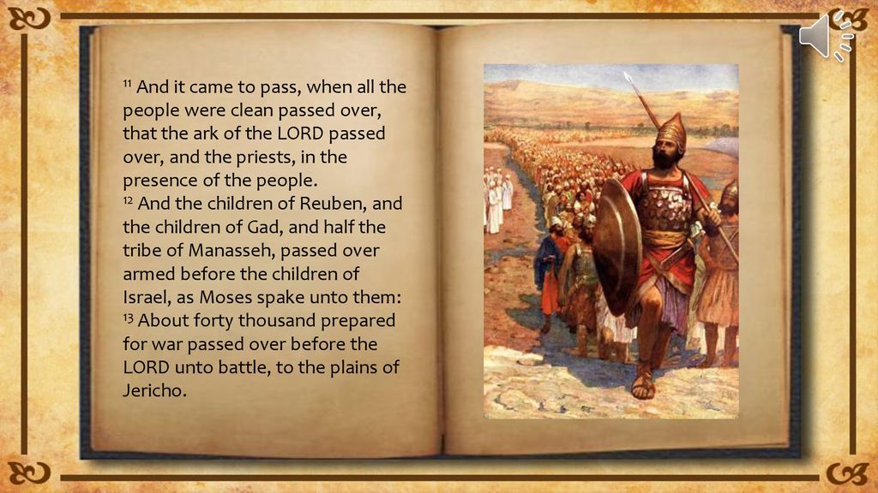
Joshua 6

Slide 51
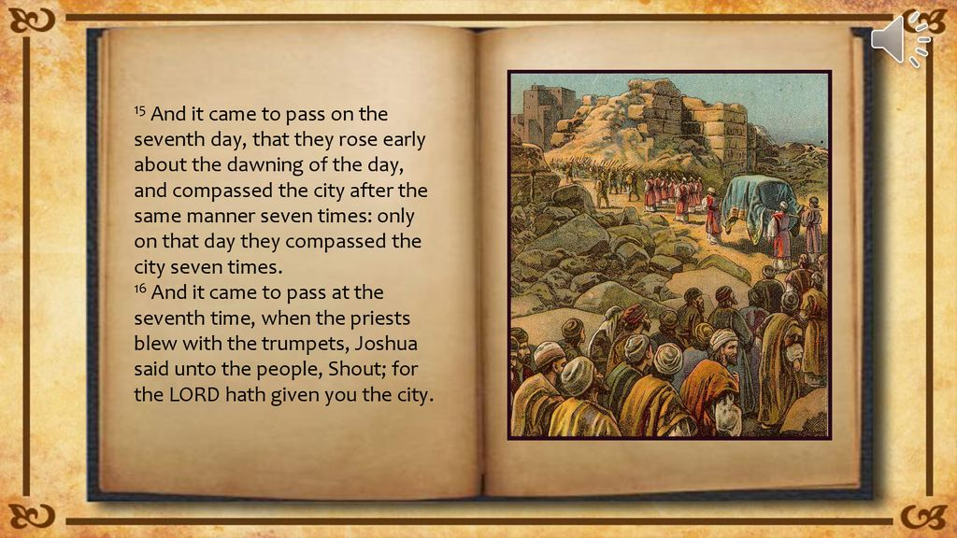

Slide 52


Slide 53

Isaiah 27:13
And it shall come to pass in that day that the great trumpet shall be blown,
and they shall come which were ready to perish in the land
of Assyria, and the outcasts in the land of Egypt, and shall worship Yahuah in the holy mount at Jerusalem.

Slide 54

From the days that preceded the Destruction of the Second Temple we still have the testimony of Philo of Alexandria about the use of the Shofar in Rosh Hashanah and the meanings attributed to it. The testimony given by that philosopher is of great importance to researchers nowadays.
The use of the Shofar on Rosh Hashanah and Yom Kippur is influenced by the principles of using the Shofar in biblical times.

Slide 55

Christians today think of the shofar as a way of relating to Jews and the land of Israel. They think of it as a symbol.
The shofar is much more than that to me. It is a way of calling Yahuah on the scene
of my life, whether it is for protection, healing, praising, worshipping, or just coming into the presence of Yah. It lifts me up
on a higher plane. It means victory to me.
55

Slide 56



Could it be that the trumpet of Yahuah is actually his voice rather than a trumpet that He places to His mouth and blows?
1 Thessalonians 4:16
“For Yahusha Himself shall
descend from heaven with a shout,
with the voice of the archangel,
and with the trump of Elohim:
and the dead in Yahusha shall rise first.”

Slide 57






When they tell us storm is
coming we take it seriously!
I blow the shofar to keep
these storms from coming
near our dwelling place!
When I go outside on our porch and blow the shofar, the storm goes around us. Praise Yahuah!

Slide 58

The sounding of the seventh trumpet will be the most dynamic event out of all the trumpets prophesied in the Bible, affecting all human beings.
It is at this last trumpet that Yahusha will send angels to rapture all saints
for their eternal reward and pass
His judgments on the fate of the earth’s inhabitants.
This event also marks the end of human government and the establishment of the Kingdom of Yahuah
on earth, for the next one thousand years.
At this time, the end time, all of what the Bible has prophesied
will come to pass and prove the power of Yahuah’s will.
That Final Trumpet!

Slide 59


Little is Much
In the harvest field now ripened
There's a work for all to do;
Hark! the Master's voice is calling,
To the harvest calling you.
Does the place you're called to labor
Seem so small and little known?
It is great if Yah is in it,
And He'll not forget His own.
Little is much when Yah is in it!
Labor not for wealth or fame;
There's a crown, and you can win it,
If you go in Yahusha's name.
.
When the conflict here is ended
And our race on earth is run,
He will say, if we are faithful,
"Welcome home, My child—well done!"
In the mad rush of the broad way, In the hurry and the strife,
Tell of Yahuah's love and mercy, Give to them the Word of Life.
Are you laid aside from service,
Body worn from toil and care?
You can still be in the battle,
In the sacred place of prayer.

Slide 60


Questions/Comments
on
Yahuah’s Shofar?
Presented by
Carolyn Shelton
questions@studythecalendar.com
www.studythecalendar.com
The End

